Slide 1
Project Presentation of CO-OP Project at Industry (Module-2) (22CS421)
On
VoiceGen-Agent: An Agentic AI Framework for Low-Latency Voice Assistants Aadit Wadhwa – 2210990002
Ajay Rana – 2210990080
Kavyam Sachdeva – 2210990501
Lokesh Garg – 2210990544
Supervised By
Dr. Lalit K. Sharma
Department of Computer Science and Engineering,
Chitkara University, Punjab

Slide 2
Introduction
Evolution of Support: Customer service has transitioned from human-operated phone hubs to automated menus and rule-based bots, finally arriving at independent, "smart" programs.
Contextual Intelligence: Modern systems differ from their predecessors by maintaining continuity; they observe context, store historical data, and recall past interactions rather than resetting every session.
Autonomous Problem Solving: Today's helpers are objective-driven rather than path-driven, meaning they can organize their own steps and adapt their behavior to reach a goal without constant human input.
The Latency Barrier: The primary hurdle for voice-driven AI is "timing" rather than "smarts." To mimic natural human conversation, responses must occur within 300–500 milliseconds, a threshold most current AI which often takes over a second, struggles to meet.
2

Slide 3
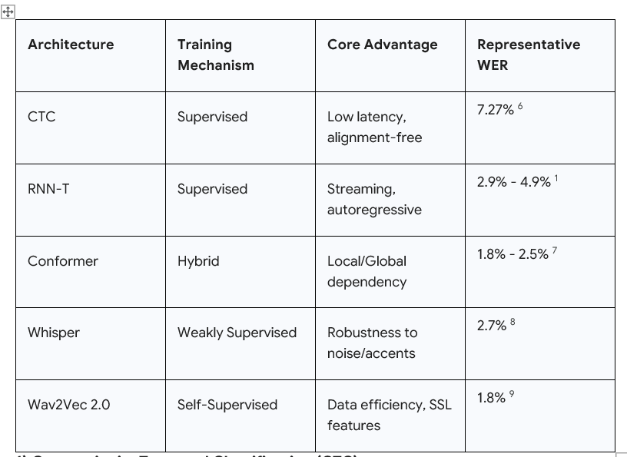
ASR (Automatic Speech Recognition)
Converts speech → text in real time
Must balance: → Accuracy (WER) → Latency (Streaming)
Top Architectures:
- CTC → Low latency - RNN-T → Streaming capability - Conformer → High accuracy - Whisper → Noise robustness - Wav2Vec 2.0 → Data-efficient
3

Slide 4
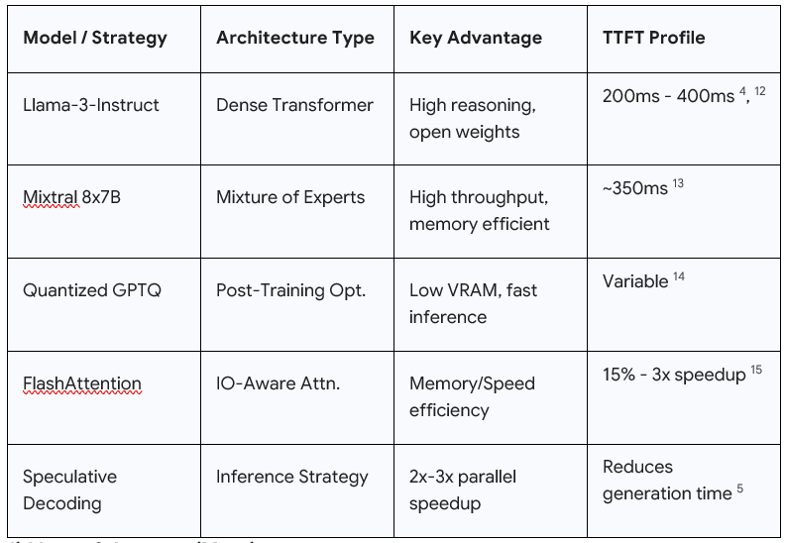
LLM (Language Understanding Core)
Converts text → meaning → response
Depends heavily on ASR quality
Key Models / Techniques: - Llama-3 → strong reasoning - Mixtral (MoE) → efficient inference - Quantization → faster, lower memory - FlashAttention → speed optimization - Speculative Decoding → 2–3x faster generation
Key Challenge:- Balance → speed vs accuracy vs cost
4

Slide 5
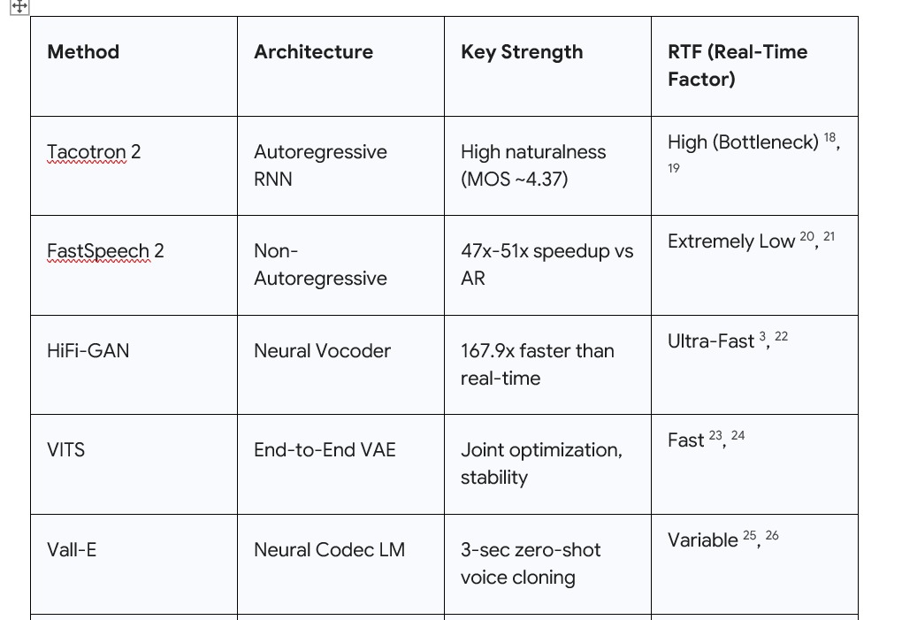
TTS (Text-to-Speech)
Converts response → natural voice output
Must feel human & instant
Top Methods: - Tacotron 2 → high quality (but slow) - FastSpeech 2 → non-autoregressive (very fast) - HiFi-GAN → ultra-fast vocoder - VITS → end-to-end synthesis - VALL-E → voice cloning
Key Insight: - Parallel generation = low latency + stable output
5

Slide 6
VoiceGen-Agent Integration
Core innovation → Parallel Processing No waiting between stages
Pipeline Flow: - Speech streams in - Partial transcription begins - LLM predicts early responses - TTS generates audio in chunks
Result: - Overlapping execution - Real-time conversational feel
6

Slide 7
Latency Optimization (Core Contribution)
Latency Breakdown: - ASR: 100–200 ms - LLM: 200–400 ms - TTS: 100–300 ms
Total Perceived Latency: < 800 ms
Why it works: - Streaming inputs - Parallel execution - Predictive generation
7

Slide 8
Impact & Conclusion
Achieves near human-like response time
Enables real-time voice AI systems
Reduces infrastructure cost by: 40–60% cost reduction
Key Takeaways: - Move from sequential → parallel AI pipelines - Combine speed + intelligence - Scalable for real-world deployment
8

Slide 9
Thank You
9

